Slide 1
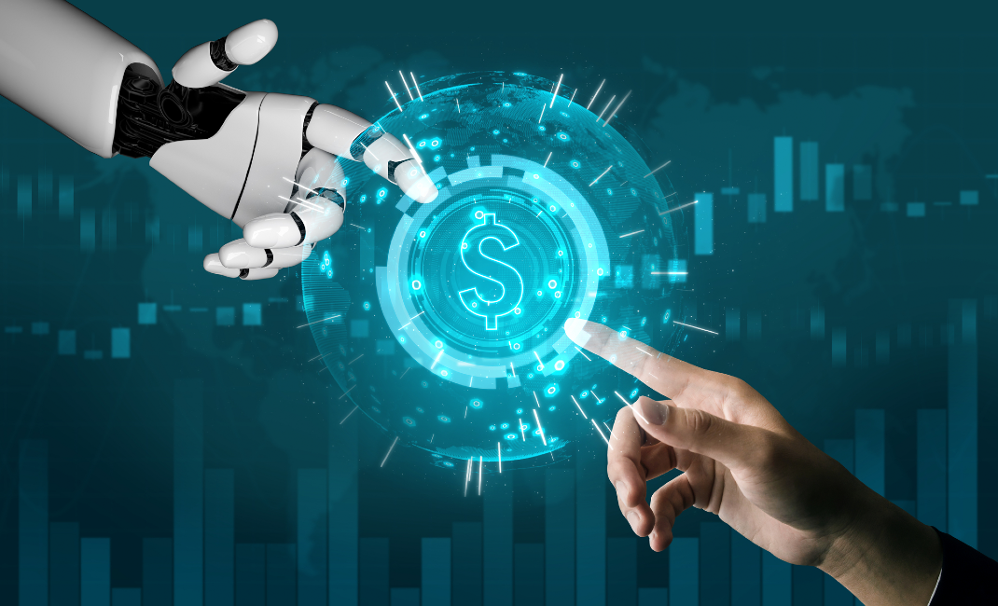
Fraud Detection For Banking
Sample Guys

Slide 2
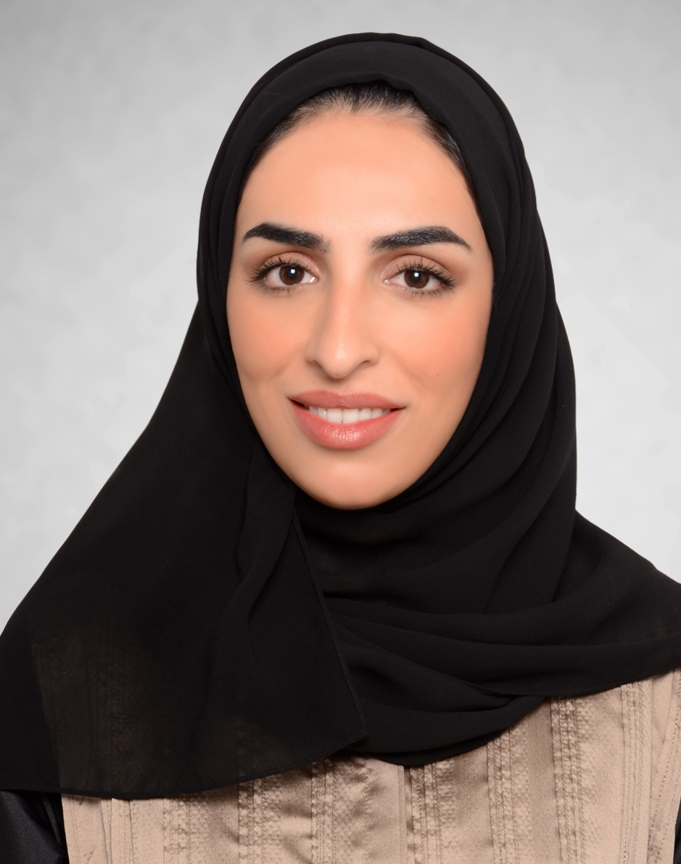
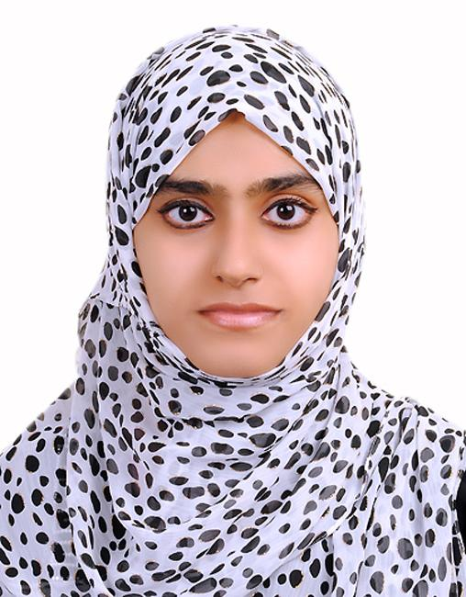


The Team
Maitha Alshaali
Information Security Analyst
Nafitha Najeeb
Finance Specialist
Dominique Duclayan
Profession
Hergen Meyer
Product Development Director

Slide 3
Fraud Detection on bank payments is a good way of putting data science for use while generating value at the same time.
Fraudulent behavior can be seen across many different fields such as e-commerce, healthcare, payment and banking systems. Fraud costs businesses millions of dollars each year.
For these type of problems ML comes for help and reduce the risk of frauds and the risk of business to lose money. With Machine Learning, detection of the fraud would be more precise and confident.

Slide 4
Problem Definition:
In this project, we are detecting fraudulent transactions from the Banksim dataset.
The Data Science Project we have selected deals with detecting fraudulent transactions and applying Machine Learning Model.
The source of the data is: https://www.kaggle.com/turkayavci/fraud-detection-on-bank-payments
The dataset consists of payments from various customers made in different time periods and with different amounts.

Slide 5
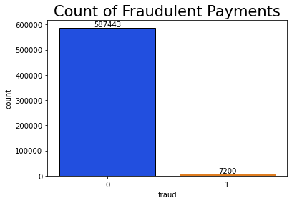

Slide 6
2. Exploratory Data Analysis
The Dataset has 9 feature columns and a target column.
Feature Descriptions:
Step: This feature represents the day from the start of simulation. It has 180 steps so simulation ran for virtually 6 months.
Customer: This feature represents the customer id
zipCodeOrigin: The zip code of origin/source.
Merchant: The merchant's id
zipMerchant: The merchant's zip code

Slide 7
6. Age: Categorized age
0: <= 18,
1: 19-25,
2: 26-35,
3: 36-45,
4: 46:55,
5: 56:65,
6: > 65
U: Unknown
7. Gender: Gender for customer
E : Enterprise,
F: Female,
M: Male,
U: Unknown
8. Category: Category of the purchase.
9. Amount: Amount of the purchase
Fraud: Target variable which shows if the transaction fraudulent(1) or benign(0)

Slide 8
2. Exploratory Data Analysis
We started with analysing our dataset and found that there was no missing data. We checked the details of the fraud transactions and the correlation with different features like age, gender etc.
Age wise analysis showed that, the number of transaction and the number of fraud transactions were more in age group 2 that is 26-35.
Gender wise analysis revealed that the number of transactions were more in female category, E and U category being negligible
The two largest categories (es_transportation and es_food) have absolutely no fraud. Another pattern emerged was higher amount transactions has higher possibility of fraud.

Slide 9
EDA - Data Engineering
EDA and advanced EDA with Data cleaning and feature engineering were done.
One-hot encoding was done for ‘category’ feature as it was not numerical. Dimensions of the features were reduced.
Irrelevant features were dropped:
'step' - as there are only 20 repetitions
'customer' - everybody can be a victim.
'age' - no obvious correlation
'gender' - no obvious correlation
'zipMerchant' - same value for all entries
'zipcodeOri' - same value for all entries
'merchant' - not a good indicator,

Slide 10
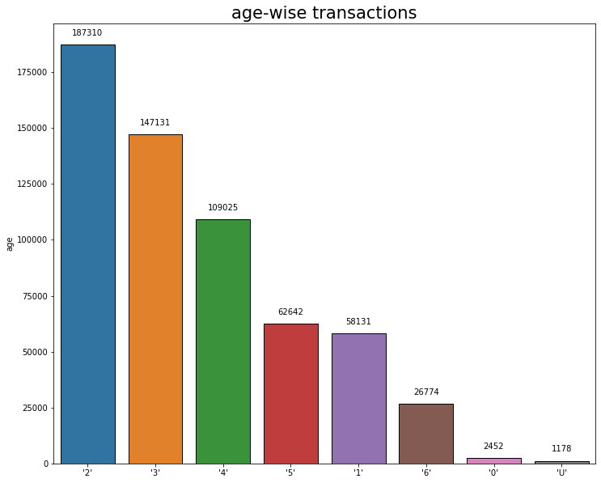
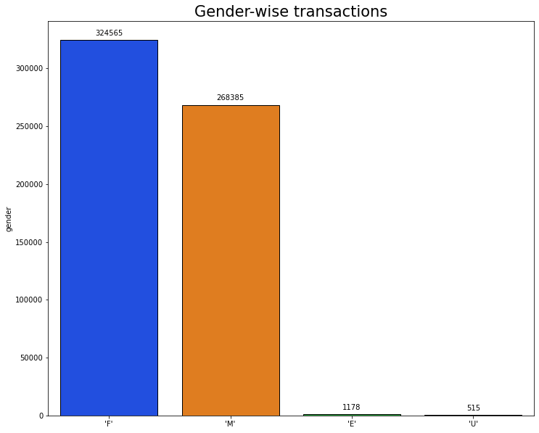

Slide 11
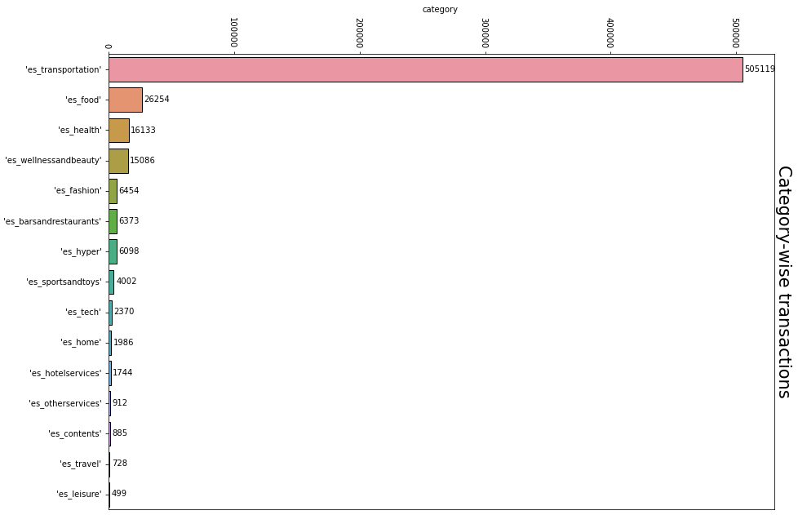

Slide 12
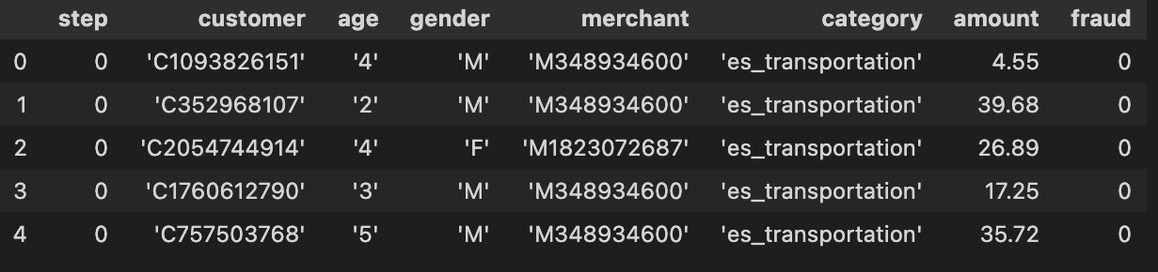
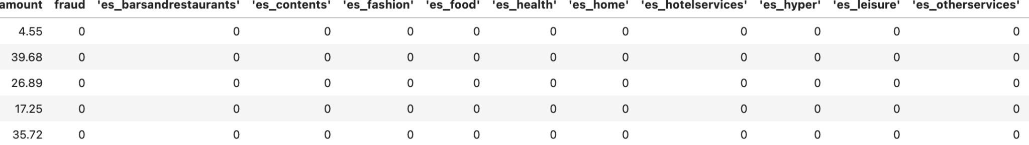
Data before EDA and Data Engineering
Data ready for Machine Learning after EDA and Data Engineering
Notes:
Slides for stages 1 and 2 upto EDA and Data Engineering done.

Slide 13
3. The Machine Learning Model

Slide 14
3. The Machine Learning Model
In this section, you will go over the following:
The name and type* of your machine learning model
The features and label for the model
The reason you chose this ML model
How this model compares to other ML models
* For example: regression, classification, or clustering.

Slide 15
4. Machine Learning Analysis

Slide 16
4. Machine Learning Analysis
In this section, you will talk about the following:
The final metrics of the model
How you trained the model
The hyperparameters used
Other improvements that could be made

Slide 17
5. Conclusion

Slide 18
5. Conclusion
In this section, you will talk about the following:
The top 3 challenges you faced in the project
The top 3 lessons you learned in this project
Next steps for your data science career
Any comments you’d like to add!

Slide 19
6. Any Questions from Audience?

